Slide 1
Optimizing Customer Retention Strategies for Retail Apparel Business
By
Karthik Murali M
24F2001293

Slide 2
Project Overview
Objective: Improve profitability and efficiency of a traditional textile shop through data-driven strategies.
Main Problems Faced:
Customer churn and low customer footfall
Credit defaulters
Poor Inventory Management
Focus Areas:
Credit & Inventory Optimization
Customer Segmentation
Demand Forecasting
Sales Trend Analysis

Slide 3
Data collected
Time period of data collected- 5 Years (September 2019 to January 2025)
Excel sheets:
Inventory Codes: Holds Inventory Codes along with names and cost price and selling price
Customer ID and Locality: Customer ID , Name and Locality
Sales : Sales data for all customers
Credit Data: Remaining Credit of each customer and amount paid in a transaction

Slide 4
SOLUTION APPROACH
Credit Risk Profiling: Segmented customers (Low, Med, High, Critical Risk)
Inventory Optimization: ABC & Pareto Analysis + ROP calculation
Customer Insights: RFM Segmentation + product preference mapping
Tools: Python, ARIMA, Prophet, Seaborn, Excel
RCA + 5 Whys for root causes (e.g., why stockouts happen)

Slide 5
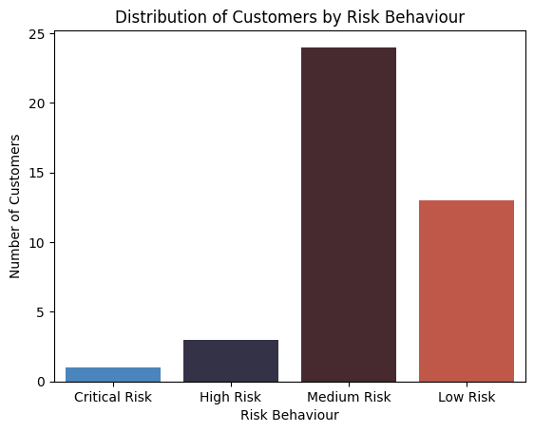
Customer Credit Risk Profiling & Segmentation
Objective : Identify high-risk credit customers and apply risk-adjusted policies to reduce overdue payments and credit losses Key Metrics Used
Total Credit Availed – Tracks credit-based purchases.
Repayment Delays – Avg. number of days late.
Credit Utilization Rate – Credit used / Credit allowed.
Outstanding Balance – Total unpaid dues.
Credit Period Overrun – How long credit period exceeded.
Risk Segmentation Logic (Short Summary)
Based on these metrics, customers were segmented into three tiers:
High-Risk: Long delays, high utilization, and overdue balances.
Moderate-Risk: Some delays and moderate balances.
Low-Risk: Timely repayments and low credit utilization.
Insights:
Most of the customer lie in the Medium Risk range followed by Low Risk indicating a need for credit restructuring.

Slide 6
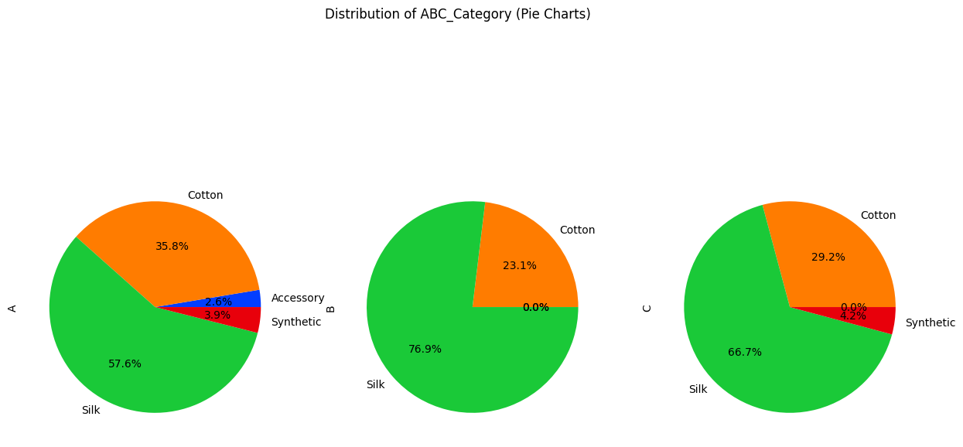
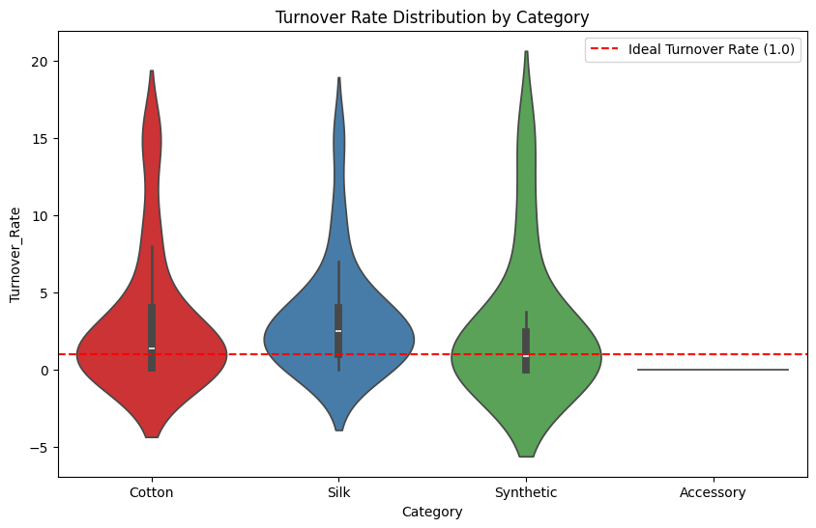
Inventory Optimization
Objective To improve inventory planning and reduce deadstock by identifying fast-moving, slow-moving, and overstocked items, and aligning procurement strategies with actual demand patterns
Analytical Methods Used:
ABC Analysis, Stock Turnover Rate
Insights Generated
Over 40% of deadstock came from low-margin synthetic items with low turnover.
Silk products had the highest revenue contribution but faced occasional stockouts.
Accessories (buttons, borders) often overstocked due to poor demand forecasting.

Slide 7
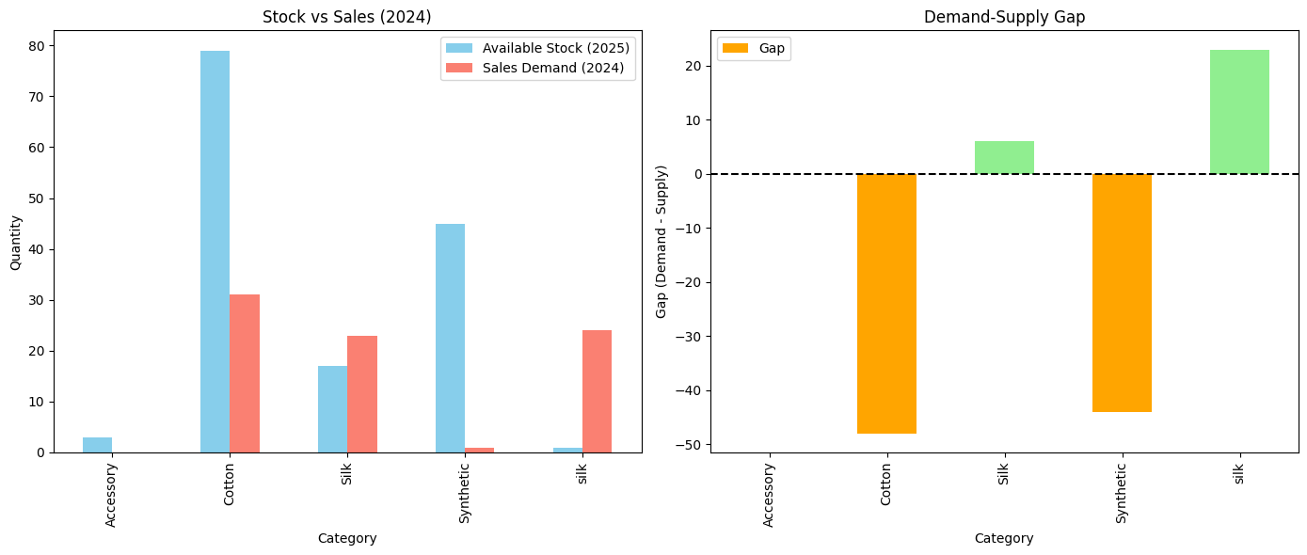
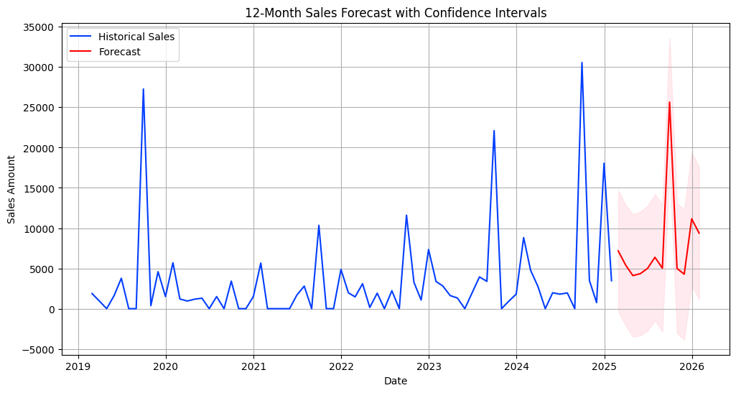
Demand-Supply Gap
Objective:To detect mismatches between customer demand and inventory availability, especially during peak festival seasons, and improve proactive planning through time series forecasting.
Key Metrics & Techniques Used:
Historical Sales Trend
Demand-Supply Gap %
Time Series Forecasting
Insights Identified
Silk: Experienced 25–30% demand spike during Diwali & wedding seasons but often understocked due to reactive procurement.
Synthetic: Frequently overstocked even during low seasons due to outdated purchase cycles.
Accessories: Showed erratic demand, but strong association with Cotton during Pongal (from basket analysis).
Stockout frequency highest in Silk (avg. 4 times/month in Oct–Dec).

Slide 8
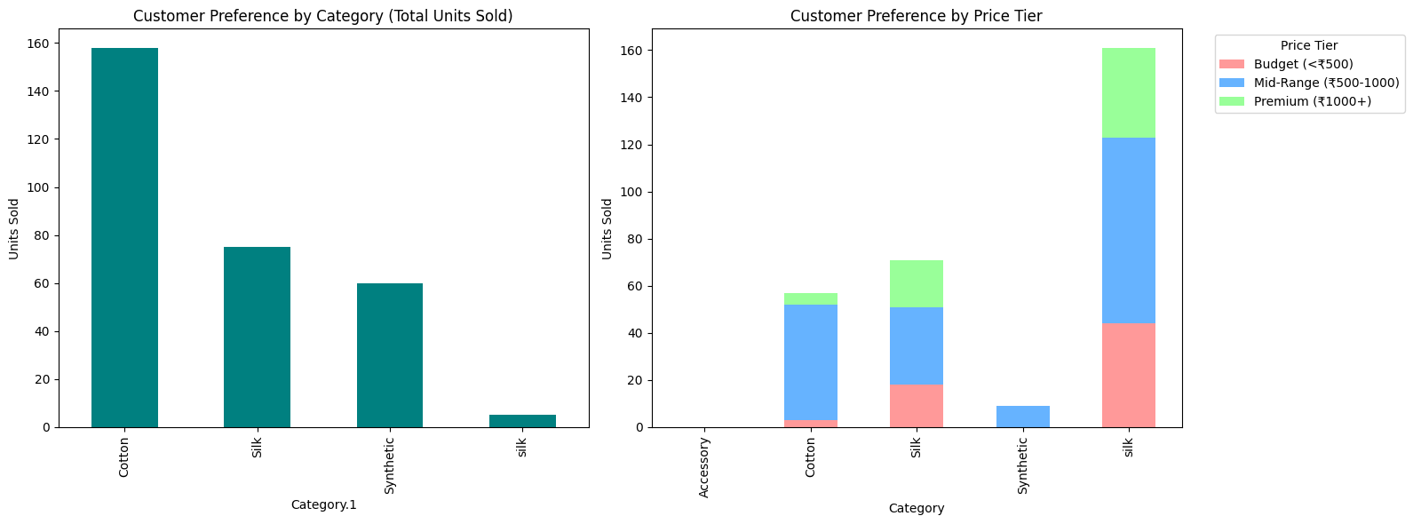
Customer Preference Analysis
Objective: To analyze customer purchasing behavior by product category and price segment, identifying trends to inform marketing and pricing strategies.
Key Metrics:
Unit Sales by Price Segment:
Breaks down unit sales across three price segments:
Low (Below ₹500)
Medium (₹500–₹1000)
Premium (Above ₹1000)
Key Insights:
Cotton: Leads in overall sales volume due to affordability, comfort, and everyday usability. It's especially relevant in climates that favor breathable fabrics. Cotton dominates the Medium Price Segment.
Silk: Ranks second in total sales but is most popular in the Premium Segment, indicating that customers are willing to pay more for luxury or festive wear. This supports strategies for premium branding.
Synthetic Products: Mostly concentrated in the Medium Price Segment, suggesting that budget-sensitive buyers are the primary consumers. They are absent from the Premium Segment, signaling limited perceived value at higher price points.

Slide 9
Recommendations Customer Segmentation & Credit Management
Credit Limit Recommendations
Low-Risk: Increase credit limit to encourage higher spending.
Medium-Risk: Cap credit at 80% of previous peak usage.
High-Risk: Reduce credit limit or require prepayment before new purchases
Positive Incentive Programs:
Offer discounts for early balance clearance.
Provide bonus credit for consistent on-time payments.
Introduce “streak rewards” — longer streaks of timely payments unlock better credit terms.
Use personalized spending challenges to improve financial habits.

Slide 10
Recommendations Inventory Optimization & Customer Retention
Data-Driven Replenishment
Use Turnover Rate Analysis to identify fast- and slow-moving items.
Set automated Reorder Points (ROPs) for high-demand SKUs like Meena Cotton and Lenin Saree.
Pre-stock high-demand categories like Silk before peak seasons (e.g., festivals in September
Demand-Supply Gap Optimization
Increase procurement for understocked but high-demand items.
Reduce procurement or run clearance campaigns for overstocked items (e.g., Cotton with surplus).
ABC Analysis Utilization
Focus tighter inventory control and procurement strategies on Category A items (Silk, Meena Cotton).
Review and optimize Category C items for clearance or repurposing.

Slide 11
THANK YOU

